Slide 1
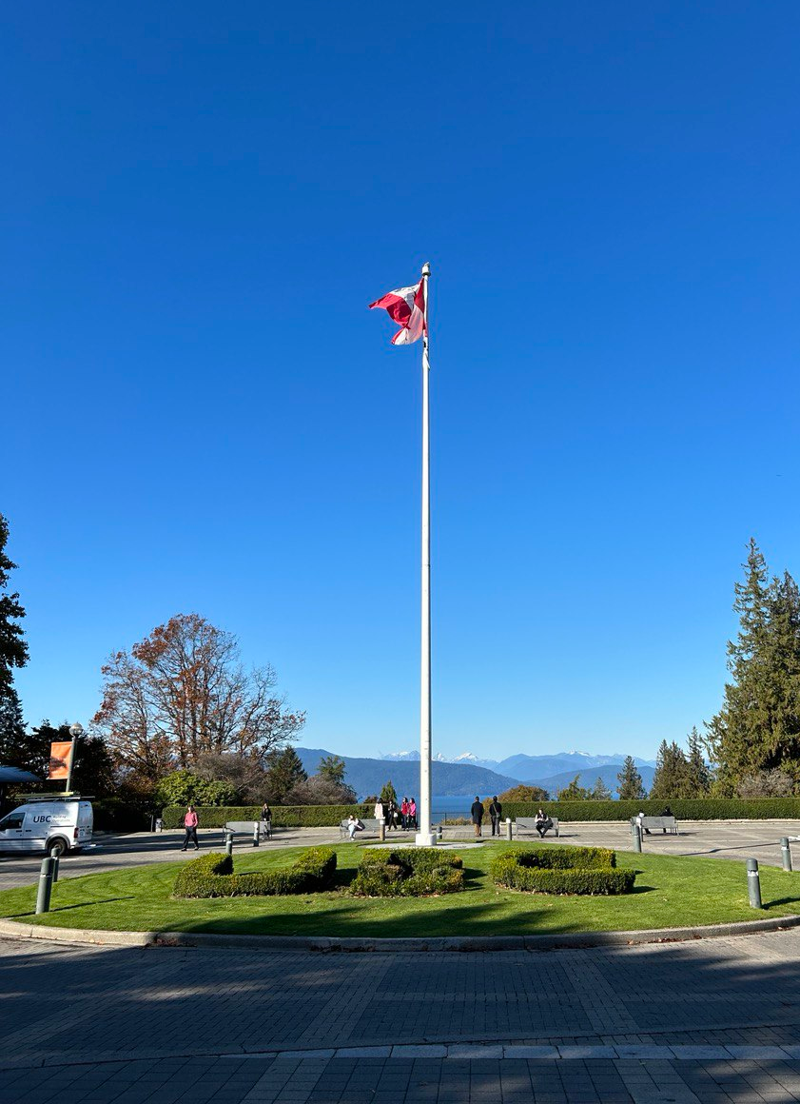
My overseas experience at ubc
(SEP-DEC ‘23)
Giacomo Giuliani, Science of Climate (II)

Slide 2
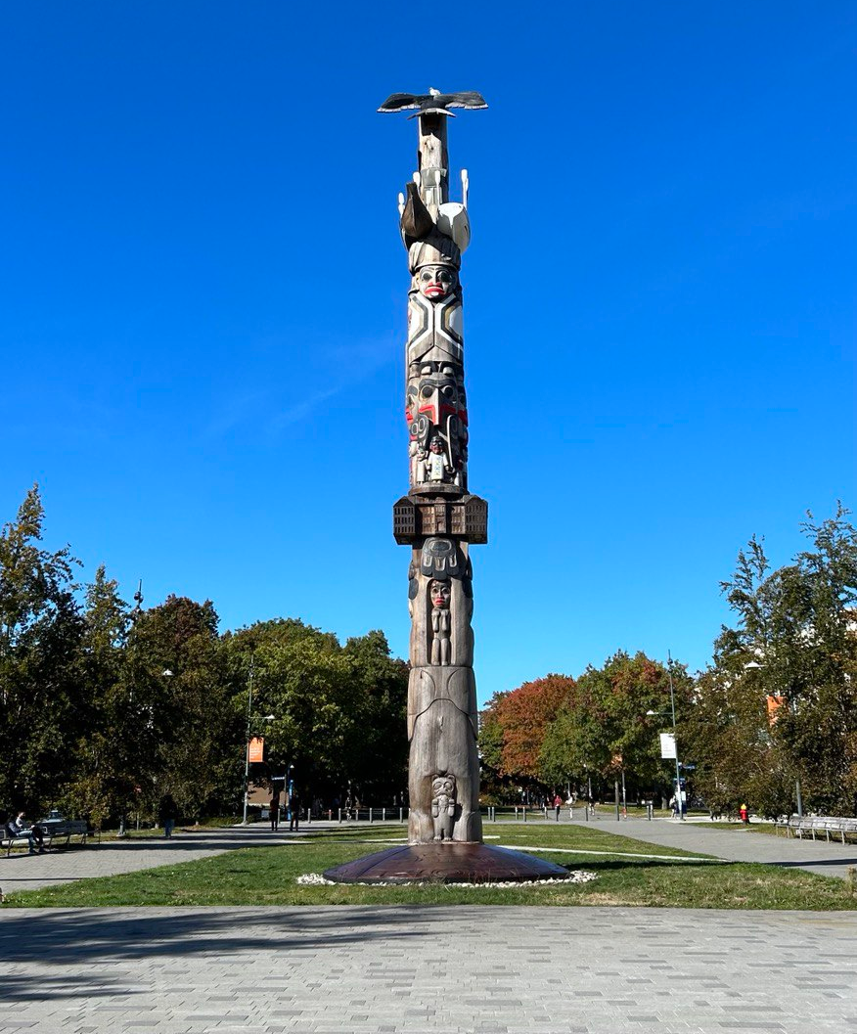
LIST OF CONTENTS
Motivation and Choice of the University
Preparation
Courses and Exams
Social Experience
Beyond University
Summary

Slide 3
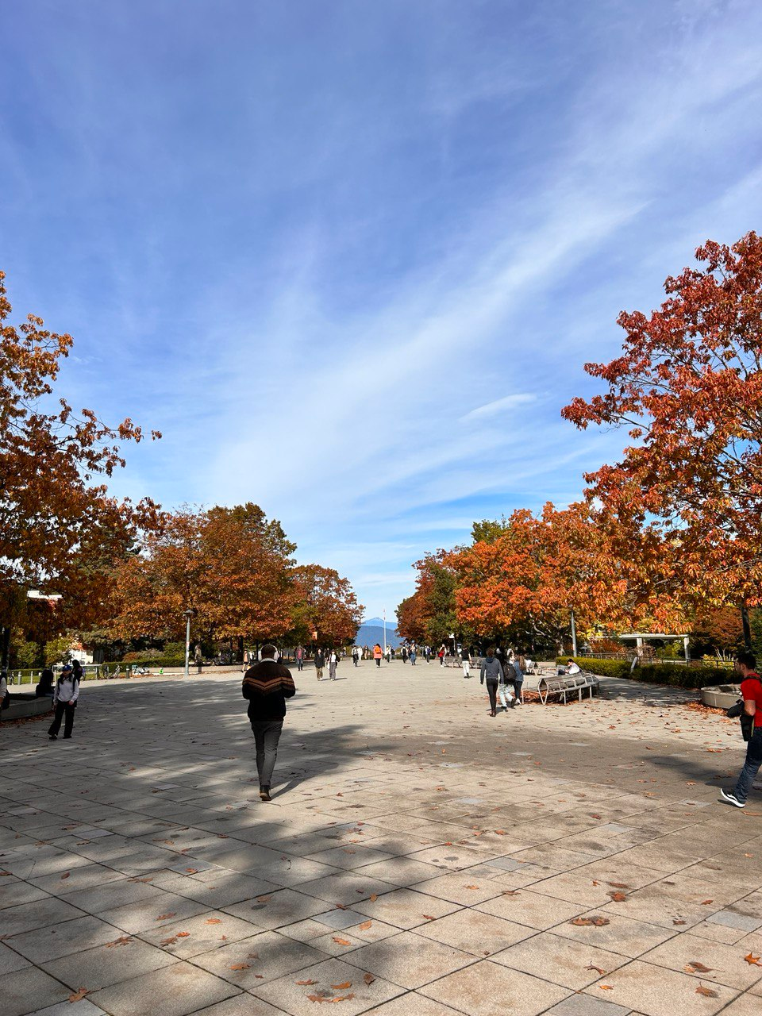
MOTIVATION
Enrichment of my international Master degree
Exposure to local research (Course on Fire Weather and Climate)
Cultural exchange in a multiethnic place
Experience of a different education system

Slide 4
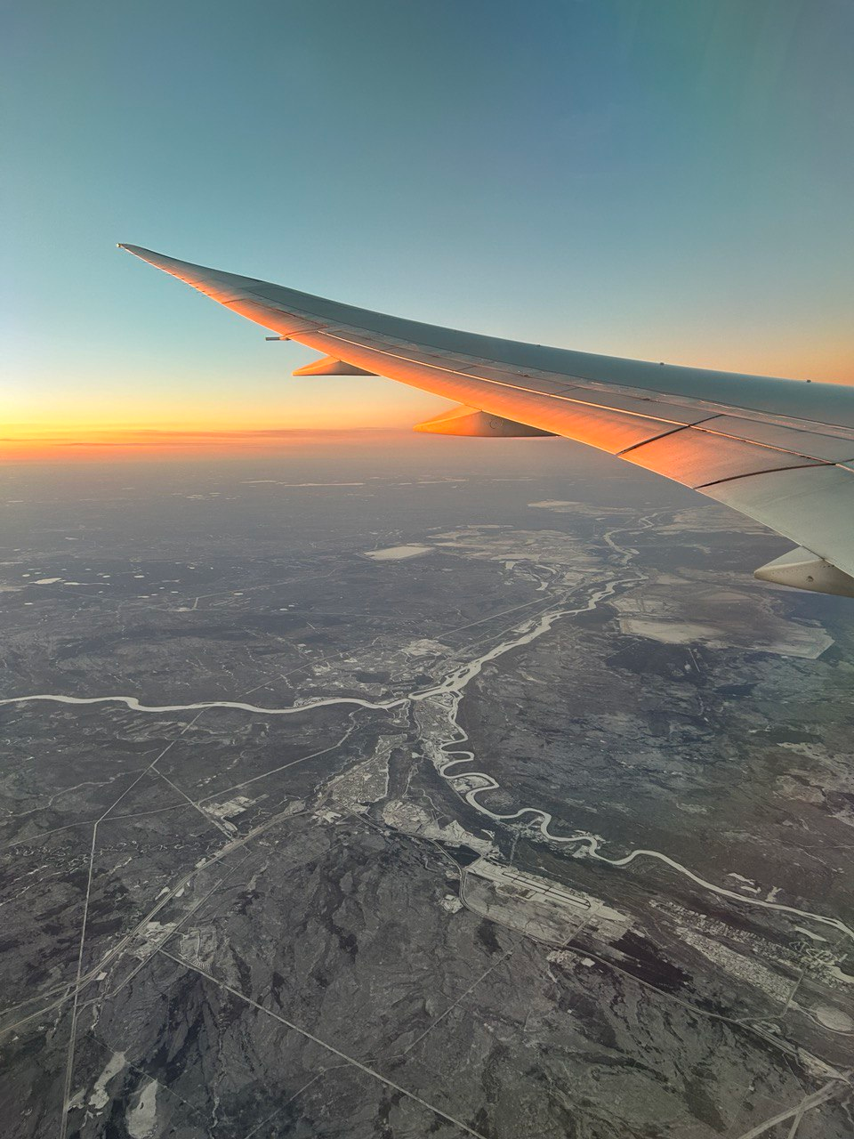
PREPARATION
Course agreement w/ UBC (suggested to write professors to reserve a seat, they are limited!)
Learning agreement w/ UniBO
Housing
VISA and insurance

Slide 5
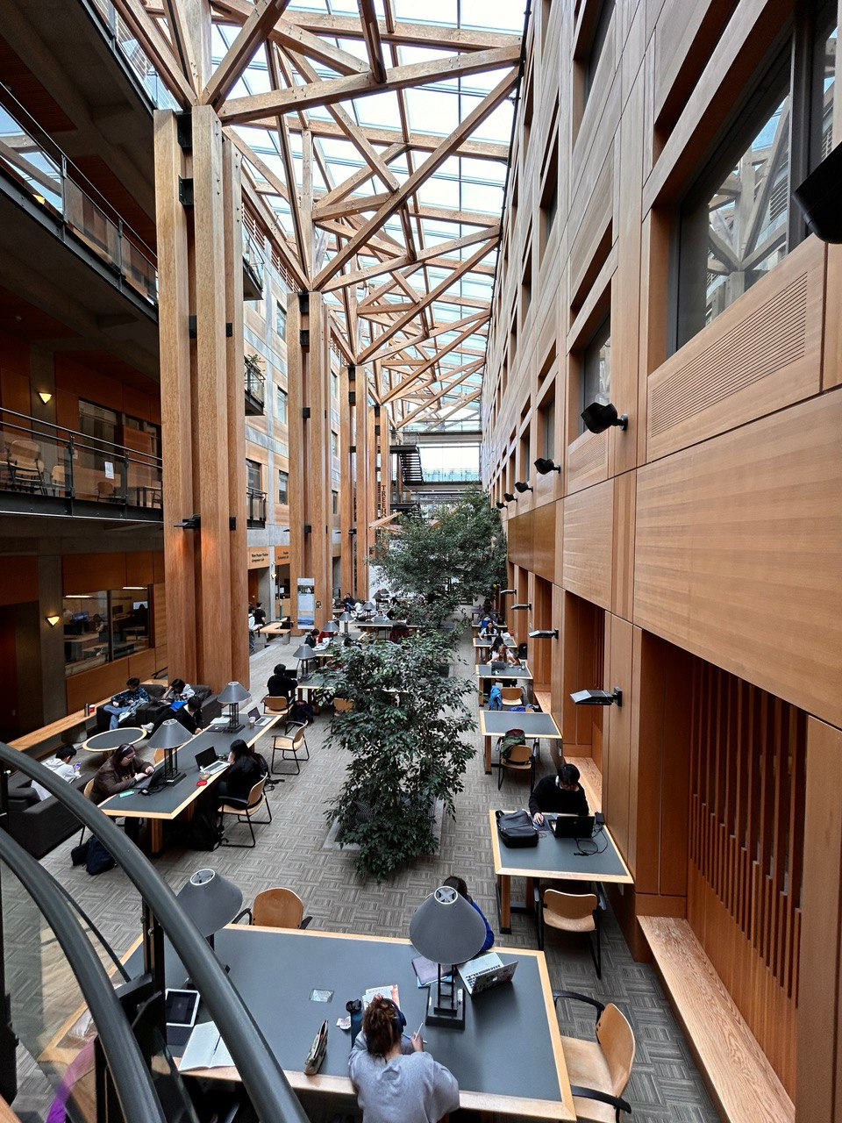
Courses and exams
(Slightly) Different method of learning
Weekly assignments and groupworks in all courses
Final grade is split among multiple evaluations (assignments, midterm, final…)
One-shot exams

Slide 6
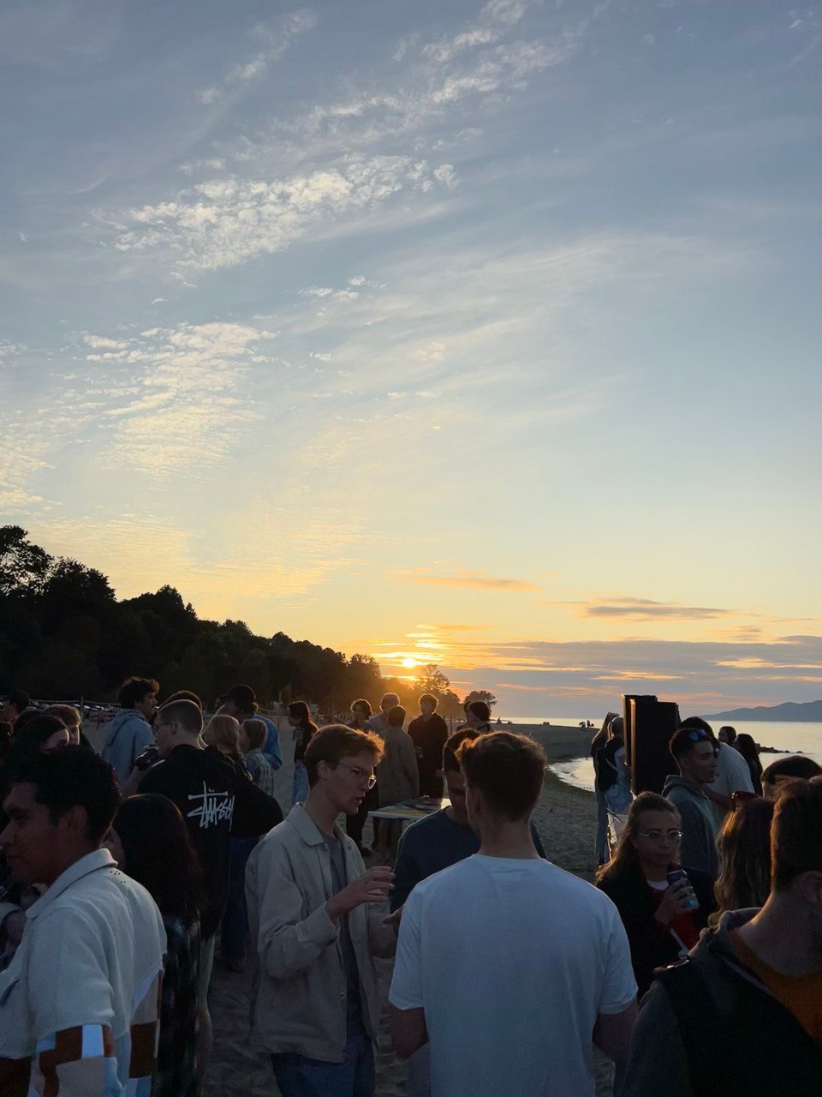
SOCIAL EXPERIENCE
(Little) Interaction with local students
Interaction with international students
Campus facilities
Clubs and Intramural League

Slide 7
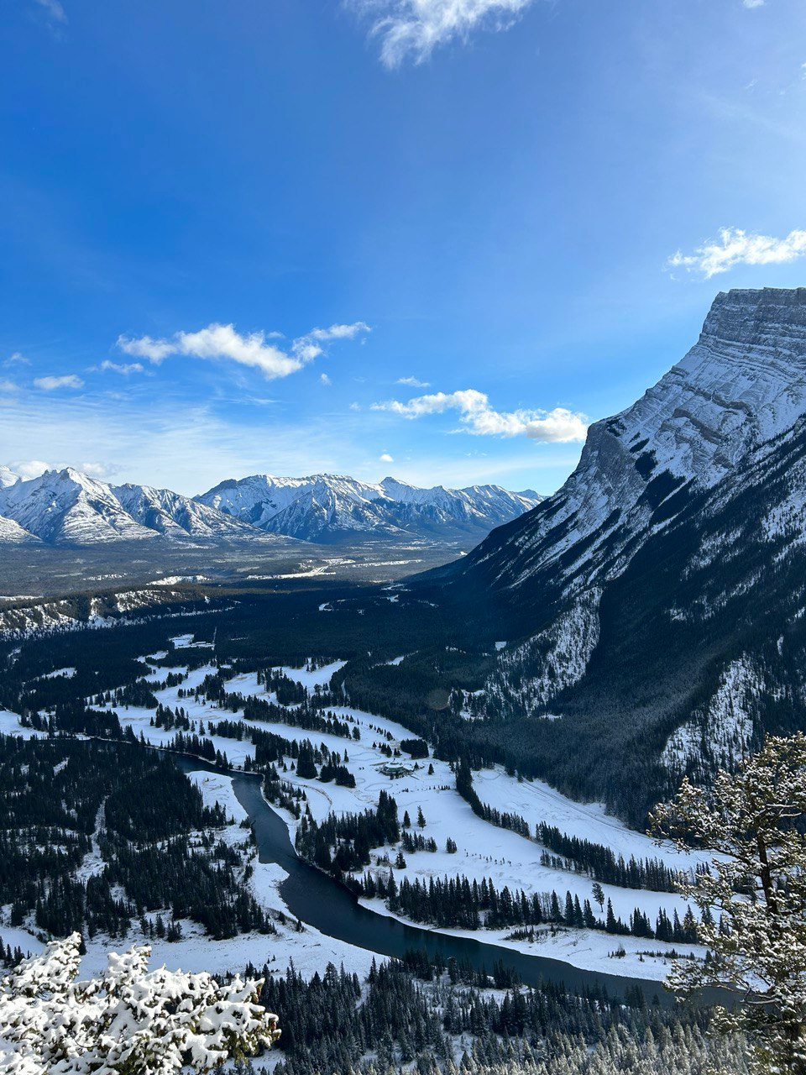
BEYOND UNIVERSITY
Travel opportunities
Highlight: the Canadian Rockies and Vancouver Island
First Nation Culture

Slide 8
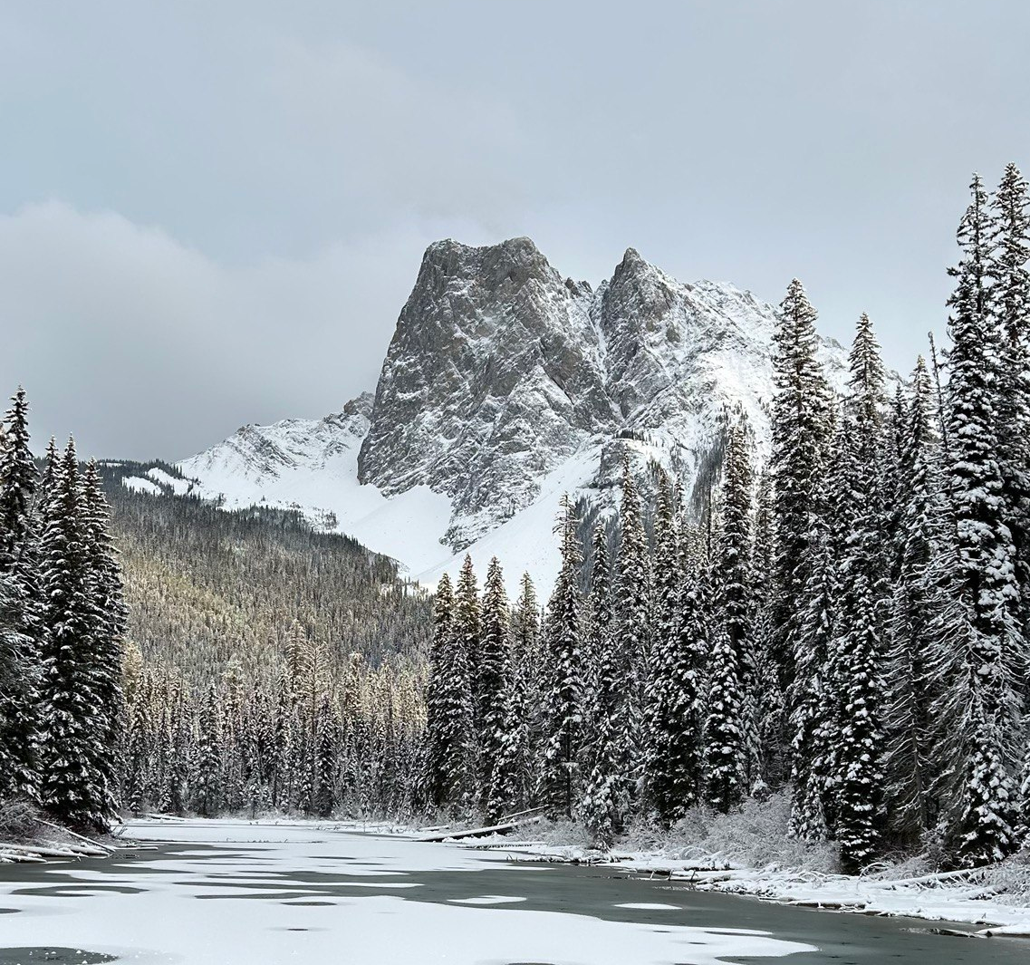
Thank you FOR LISTENING
Giacomo Giuliani -
giacomo.giuliani5@studio.unibo.it

