Slide 1
OPEN DAY - INTERNATIONAL MASTER’S DEGREE
LANGUAGE, SOCIETY AND COMMUNICATION
Programme Director - Prof. Ana Pano Alaman
LSC Degree Programmes presentation
LSC How to apply – application process
Talk with our students about LSC
29th November 2023 1:40 -2:20 p.m.

Slide 2
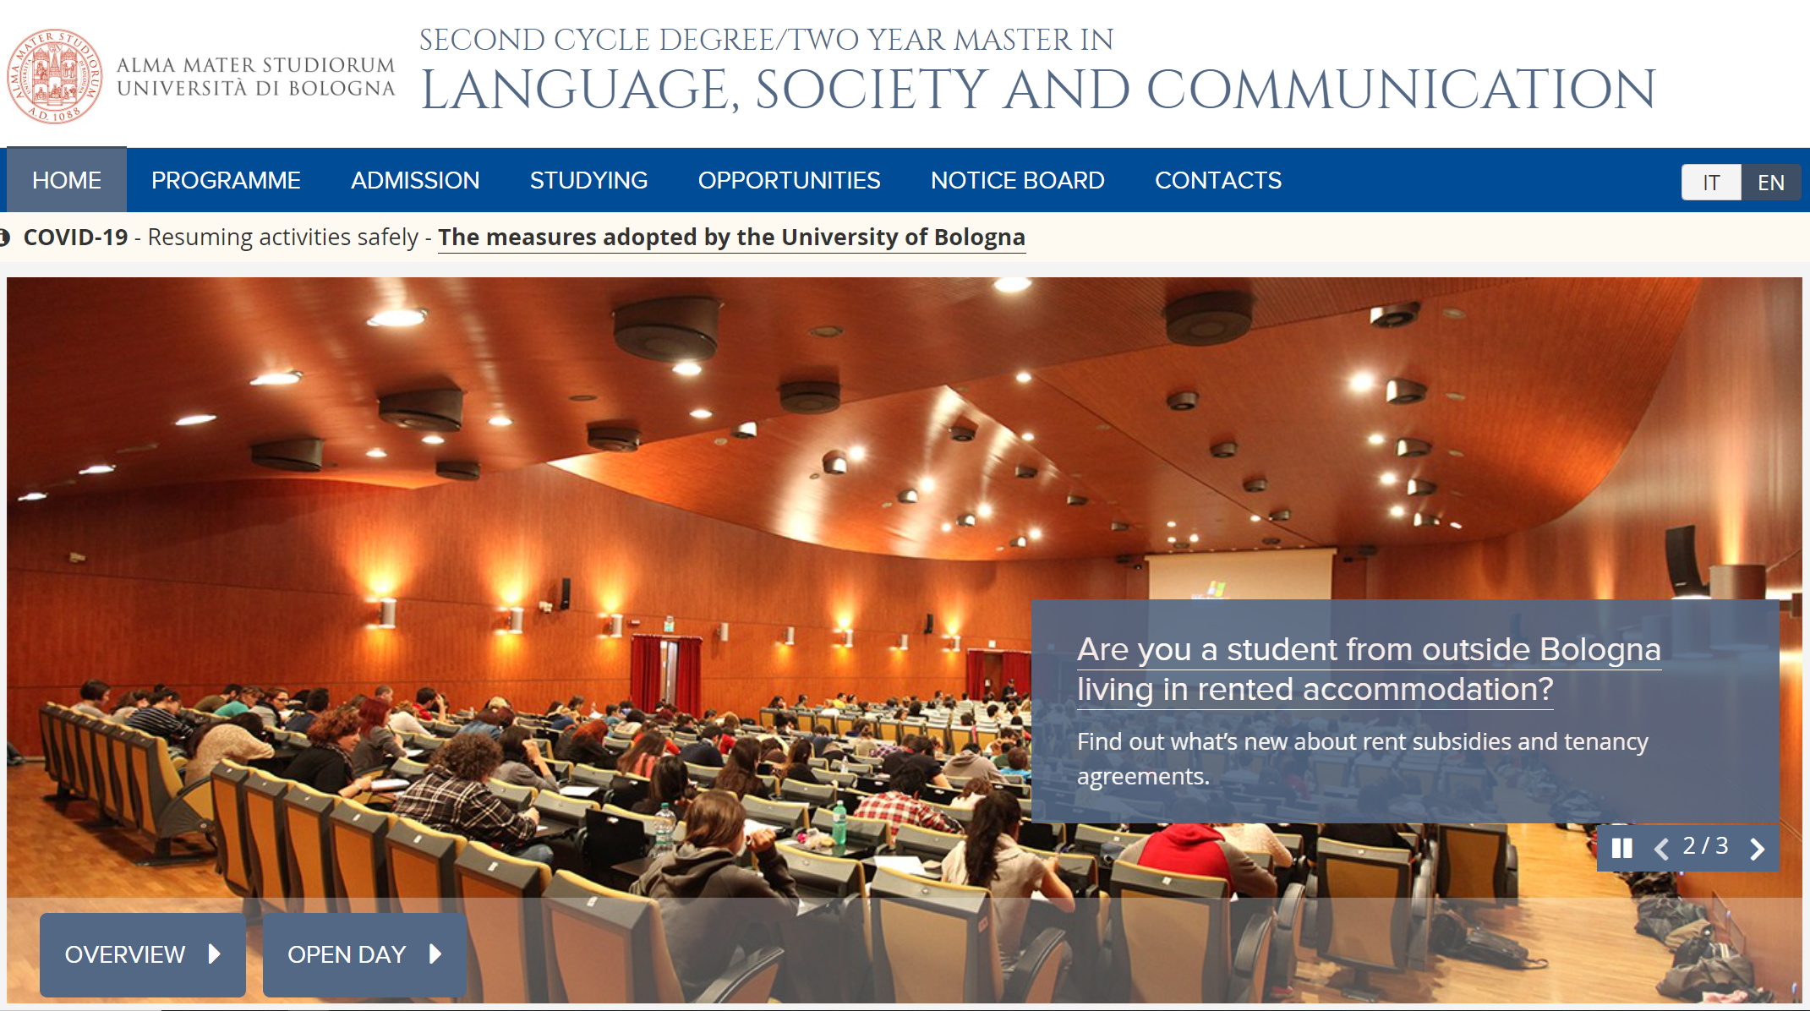
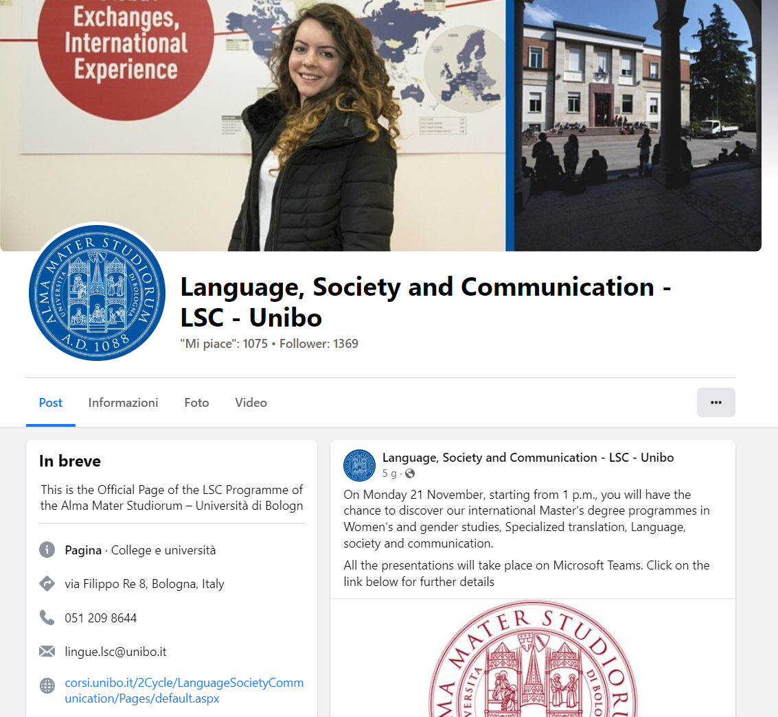

Slide 3
About LSC
A range of subjects in the areas of :
Modern Languages (English, French, German, Spanish and Russian)
Linguistics (Sociolinguistics, Psycholinguistics, Computational Linguistics…) > discipline in the 1st year, taught in Italian (B2, possibility of courses at the Linguistic Centre of the University)
Historical, Geographical, and Social Studies (Geography of languages, Web society and globalization, Humanitarian Communication, Cultural economics…)
ICT applied to Human Sciences - Natural Language Processing, Semantic web, Knowledge Graphs applied to cultural heritage

Slide 4
5 good reasons to choose this Master
Multilingual - Knowledge of several languages is fundamental in today’s society.
Intercultural - In-depth preparation for the development of interlinguistic and intercultural competences; enhances dialogue between language and cultures.
Updated - This course prepares for the challenges of a extremely complex world.
Open to diversity - Broadens one’s horizons to develop a greater understanding of different cultures, values, traditions.
Focused on communication as a bridge to understanding different communicative contexts with the contemporary world

Slide 5
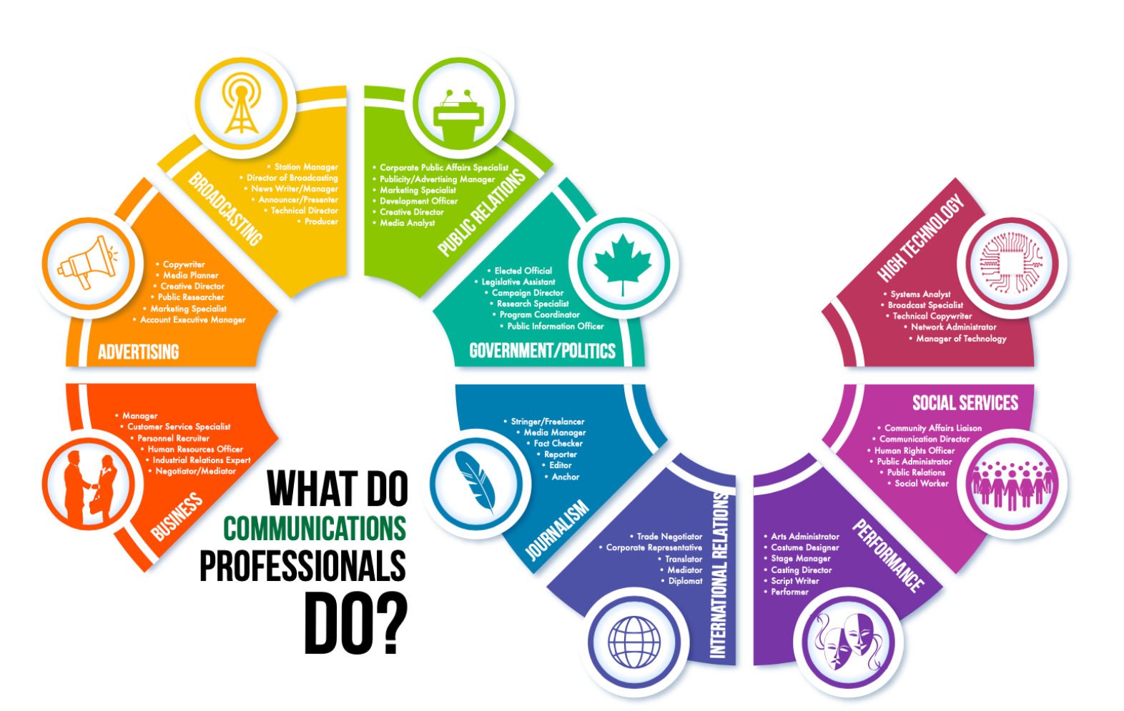
Career opportunities
Expert in Language and Culture for International Relations
Text Editor and Sub-Editor in Multiple Languages

Slide 6
Course Structure Diagram / Study Plan: https://shorturl.at/iADS0
First year
Linguistics, Languages for Specific Purposes, Translation, History, Mediation… related to 2 foreign languages (36 ECTS): you have to choose two disciplines for each language > These include practical language activities
Linguistics courses (9 ECTS)
History, Economics, and Geography courses (9 ECTS)
Knowledge engineering and Computation for the Humanties (former Information Technology Skills) (6 ECTS)

Slide 7
Course Structure Diagram / Study Plan: https://shorturl.at/iADS0
Second year
Linguistics, Languages for Specific Purposes, Translation, History, Mediation… related to 2 foreign languages (36 ECTS): you have to choose one discipline for each language > These include practical language activities
Supplementary disciplines (9 ECTS):
Elective disciplines (9 ECTS) – Includes Internships and Seminars
Final Examination (24 ECTS) – Opportunity to associate it to a mobility exchange and/or to an internship (also abroad)

Slide 8
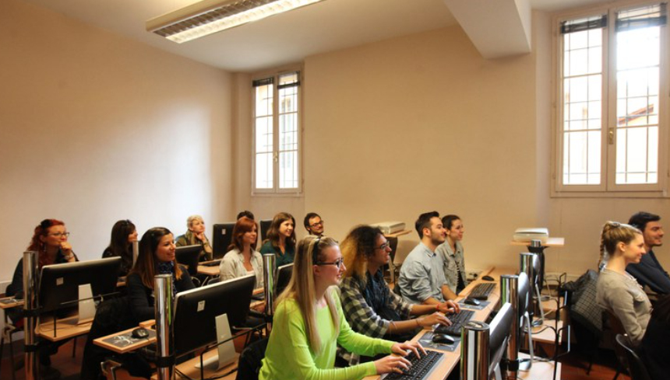
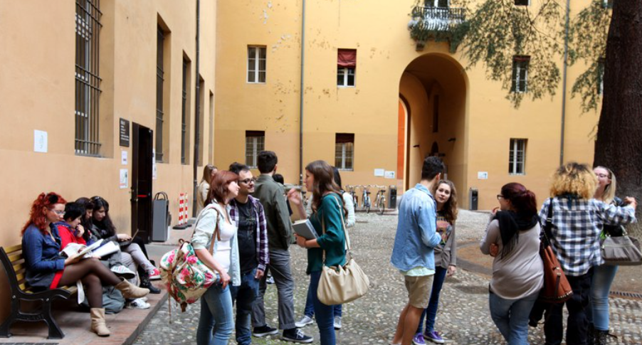
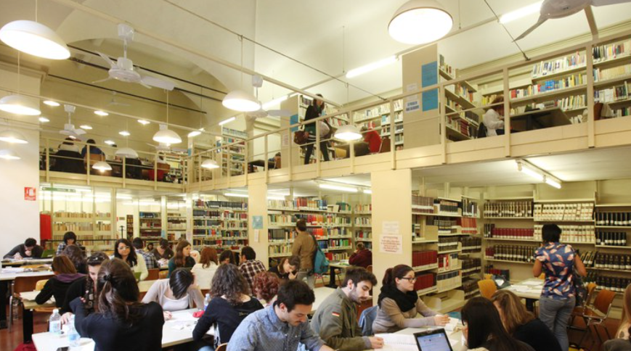
ICT equipped classrooms, study rooms, library and much more

Slide 9
How to apply – Admission: https://shorturl.at/bkwzP
CALL FOR ADMISSION
A.y. 2024/25
Mid-February 2024
In order to be admitted students should
Possess specific curricular requirements;
Undergo an interview designed to assess their Personal Academic Background. The result of the interview will lead to an assessment of eligibility or non-eligibility to admission;
Demonstrate their knowledge of the English Language (equal at least to B2);
Requirements and admission process depend on the Degree held by candidates (Italian or Foreign Degree).

Slide 10
Admission – Foreign Degree: https://shorturl.at/bkwzP
Curricular requirements
Bachelor’s Degree that certifies a theoretical and a practical knowledge of 2 foreign languages (English, French, German, Russian, or Spanish);
Proof of knowledge of English by means of an accepted English Language Certificate, issued in the last 24 months; or an interview with a Commission
Candidates from an English-speaking country holding a Foreign Degree, or candidates with a Foreign Degree issued by an English-speaking country institution are exempted!

Slide 11
Admission – Italian Degree: https://shorturl.at/bkwzP
Curricular requirements
Bachelor’s Degree (1st Cycle Degree) with a minimum final mark of 105/110;
48 ECTS* in 2 modern languages (English, French, German, Spanish, Russian) studied previously (24 ECTS per language);
If you have not studied English in your First Degree, you should provide an English Language Certificate accepted by the Programme and issued in the last 24 months; or pass an interview with a Commission
Students from an English-speaking country are exempted!

Slide 12
Admission – Italian and Foreign Degree: https://shorturl.at/bkwzP
Assesment of personal academic preparation:
It will be evaluated through an interview. The result of the interview will lead to an assessment of eligibility or non-eligibility to admission;
the interview will be carried out in 1 of the 2 foreign languages that you plan to study further, provided that it is not English.
It will focus on:
the student’s skills and knowledge with reference to the Degree Course Objectives;
the student’s motivations to apply for the MA programme in LSC;
the language proficiency (equal at least to B2).

Slide 13
LSC How to apply – application process
Teaching Office – Ufficio Didattico
The Teaching Office is a hub for all the Course’s teaching activity; provides students with administrative help during the different phases of planning and managing learning activities
LSC Students may contact the Programme Coordinator, Enrico Carlini
and/or the Tutor for international students, Rachele Fioritti
lingue.lsc@unibo.it
rachele.fioritti@unibo.it

Slide 14
Student Administration Office – Segreteria Studenti
The Student Administration Office deals with all the career procedures and gives information on enrollments, tuition fees, exemptions, University transfers, suspension of studies, withdrawal from studies, Final Examination and Graduation Application, Certificates etc.
Virtual Desk (through Zoom)
Tuesday: 9 am to 12 noon and 2 to 3:30 pm
Wednesday: 9 am to 12 noon
Thursday: 2 to 3:30 pm
Friday: 9 am to 12 noon
Contact: segscform-lingue@unibo.it

Slide 15
International Desk
The International Desk offers information on immigration procedures, residence permit, guidance on arrival in Italy and on the services available at the Bologna Campus, Unibo Action 2 study grants, Unibo for Refugees project.
On-site Desk, Via Marsala 49/A, Bologna: Tuesdays 14:30-16:00
Virtual Help Desk: Monday and Wednesday 10:00-12:00, Thursday 14:30-16:00
Contact: internationaldesk@unibo.it

Slide 16
Contacts
Prof. Ana Pano Alaman, Director of the Academic Programme (ana.pano@unibo.it)
Dott. Enrico Carlini, Programme Coordinator (lingue.lsc@unibo.it)
Prof. Rachele Fioritti, Tutor for international students (rachele.fioritti@unibo.it)
Prof. Maria A. Rieger, President of the Commission of Evaluation (marie.rieger@unibo.it)
Student Administration Office (segscform-lingue@unibo.it)
International Desk (internationaldesk@unibo.it)

Slide 17
Department of Modern Languages, Literatures and Cultures
http://www.lingue.unibo.it
http://corsi.unibo.it/2Cycle/LanguageSocietyCommunication
lingue.lsc@unibo.it
Fai clic per aggiungere del testo

